Slide 1

Studying 101
Pro tips on how to study

Slide 2

First of all.. Manage your time, right now. Like today.
Open your Google calendar and/or a planner and look at your class schedule and syllabuses.
Usually the chapters in the course are listed and books are too!
To make life easier you can sync your Canvas to your Google calendar to see upcoming assignments and when class is. Or you can manually enter items in. Either way you need to keep track of the amount of hours you spend on school/studying.

Slide 3
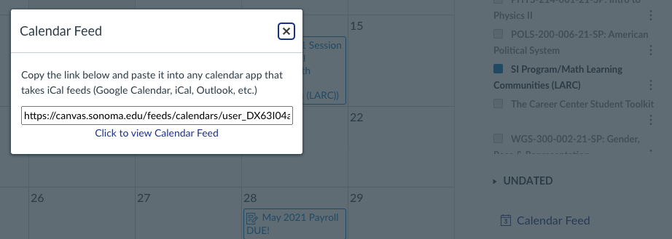
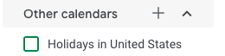
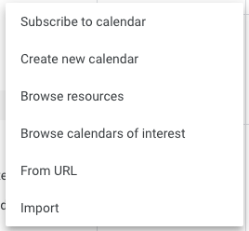
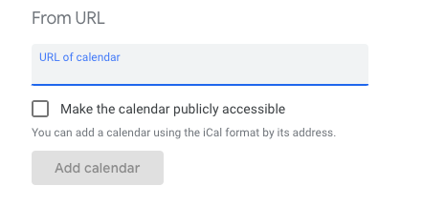
How to Sync Canvas to Google Calendar or any Calendar
2. Go to Google calendar and click the “+” near other calendars
Go to Canvas calendar and click Calendar feed and copy the link
3. Click “From URL”
4. Paste URL from canvas calendar feed and click add calendar!

Slide 4
Second, get rid of “I can’t,” “I don’t have time,” and “It’s too hard.”
Don’t limit yourself on the material, as long as you put in the hours you will be fine.

Slide 5
How to stay ahead/on top of course work
So now that you have your calendar synced and organized, let's add in the time you need to study to stay ahead of the game.
Put studying time in your calendar or agenda!
Units matter, they depict the amount of hours to study per week for each class.
Look at Course material in syllabus, such as chapters in textbook and label them in your calendar to read ahead/take notes!
Important
Studying 101

Slide 6
What to do during Study time…
Find course chapters and read ahead/take notes
Look at Course material in syllabus, such as chapters in textbook and label them in calendar to read ahead/take notes!
Search for videos on the topic to get a better understanding
Book appointments with LARC Tutors to ask questions or to review material
Homework is a part of studying time too (Practice makes perfect)
Study...
But sometimes it can be hard to be productive. I get it, so here are some tips on how to break procrastination!

Slide 7

Studying resources/tools
Desmos (graphing tool)
Quizlet
Practice problems in the back of book
Flash cards
Study buddy
Whiteboard
Kahoot
Office hours
Calendar

Slide 8

Take breaks in between studying
30 min - 1 hour… (don’t want to procrastinate)
Watch a movie or one or two episodes of your favorite show
Take a walk
Go for a swim
Workout
Take a nap
Eat some food

Slide 9

Last but not least...
You’re going to do great! AS long as you put in the time and effort, you will accomplish so much this semester with confidence in all classes.

